Slide 1
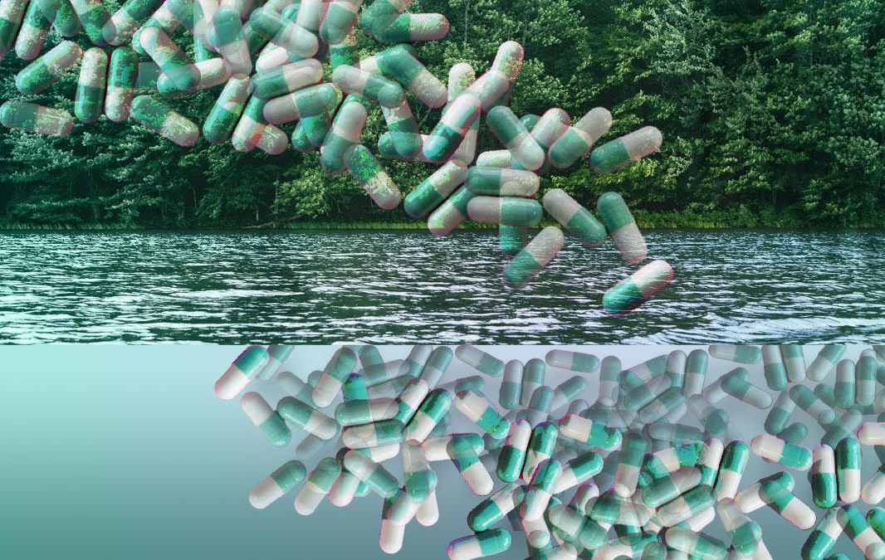
Pharmaceutical pollution of the world’s rivers
A Growing Threat to Ecosystems and Human Health
ENV-512
Marit Nys
Lorenzo Prato
Jessica Tiago G.
Source: Over 40 Percent Of World’s Rivers Contain Harmful Levels Of Pharmaceutical Drug Pollution - Dr. Rath Health Foundation

Slide 2
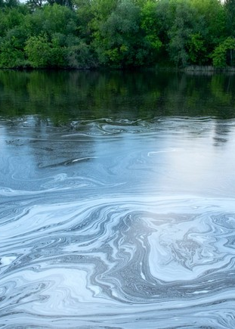
Agenda
Introduction
Socio-Economic Disparities
Impacts
Solutions
Conclusion
Source: https://nhm.ac.uk/discover/news/2022/july/drug-pollution-threatening-water-quality-worlds-rivers.html

Slide 3
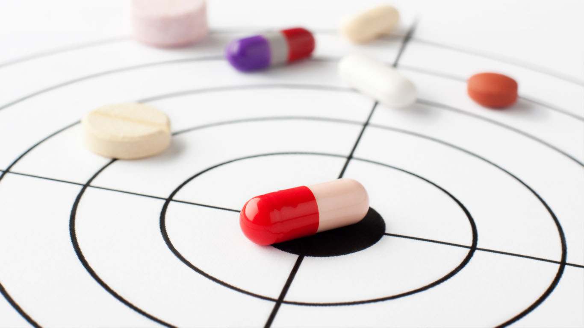
Pharmaceutical compounds
Used to treat, manage, and prevent health conditions in humans and animals
  Epilepsy: carbamazepine
  Type 2 diabetes: metformin
  Lifestyle consumables: caffeine, nicotine
  Painkiller: paracetamol
  Anti-malarial medicine: artemisinin
Active pharmaceutical ingredients (APIs): active components in a pharmaceutical drug that produce the required effect on the body to treat a condition
Source: goal-01.jpg (1366×768)

Slide 4
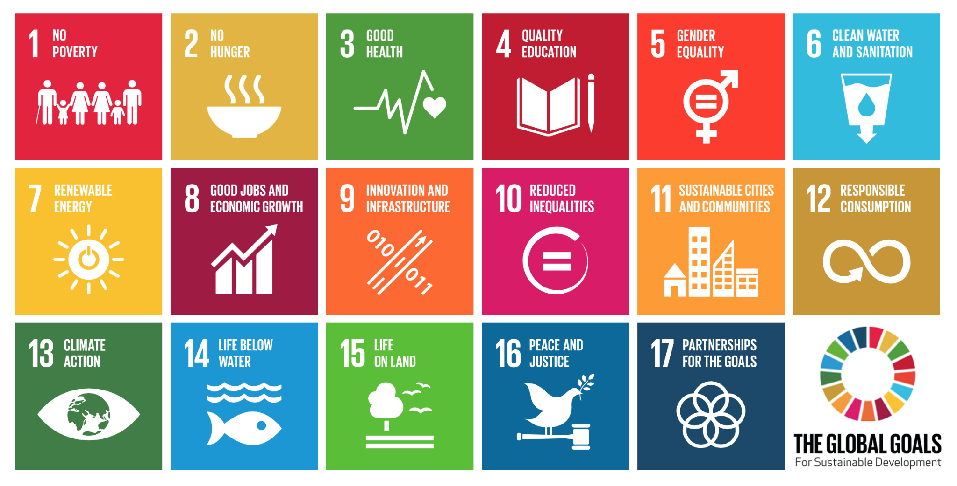
Sustainable Development Goals

Slide 5
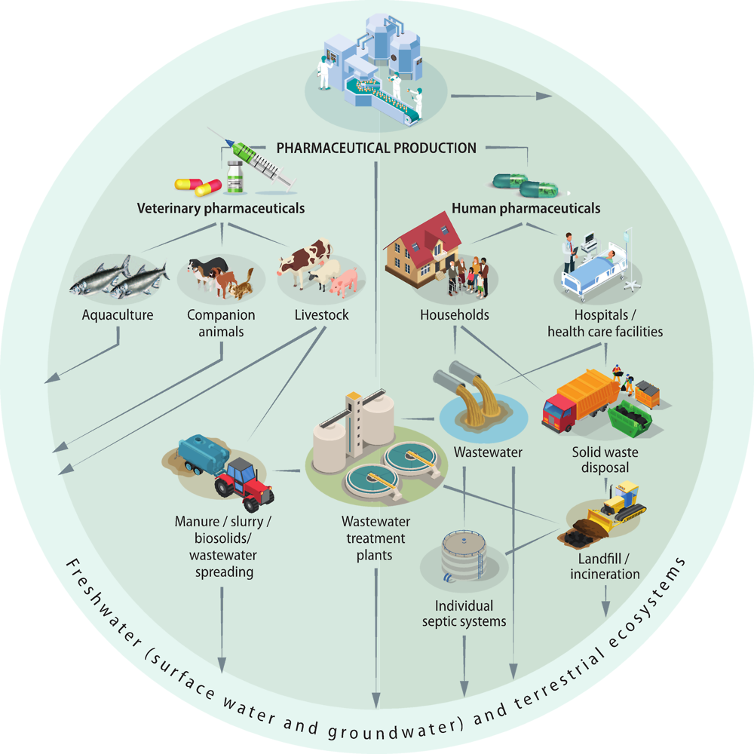
Sources
Source: Page Rendering Error | OECD iLibrary

Slide 6
PNAS’ recent study on APIs (2022)
"Typically, what happens is, we take these chemicals, they have some desired effects on us and then they leave our bodies,"
"What we know now is that even the most modern efficient wastewater treatment plants aren't completely capable of degrading these compounds before they end up in rivers or lakes."
Dr John Wilkinson, who led the research, BBC News.

Slide 7
Problems found on site
Source: Page Rendering Error | OECD iLibrary

Slide 8
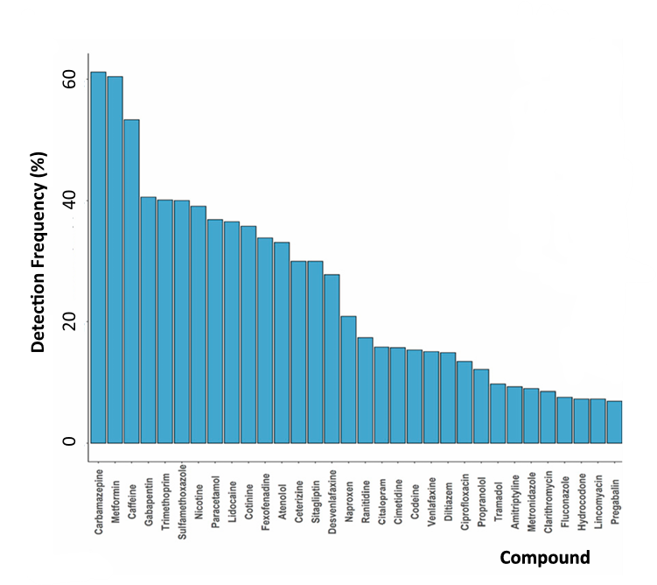
Other results of the study
Epilepsy: carbamazepine
Type 2 diabetes: metformin
Lifestyle consumables: caffeine, nicotine
Painkiller: paracetamol
Source: Pharmaceutical pollution of the world’s rivers

Slide 9
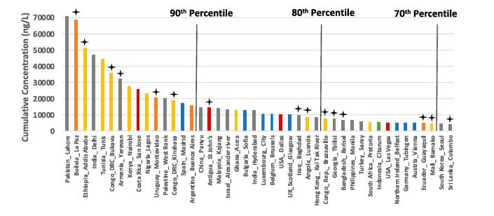
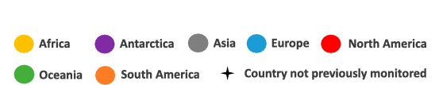
Other results of the study
Source: Pharmaceutical pollution of the world’s rivers

Slide 10
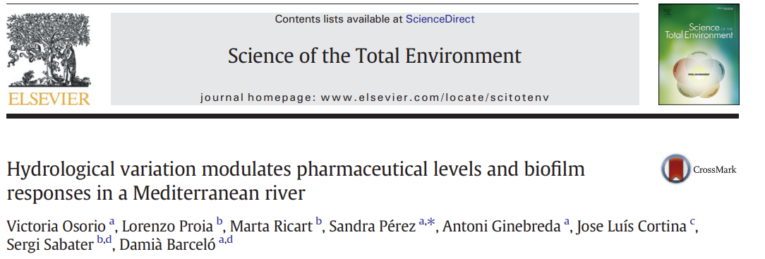
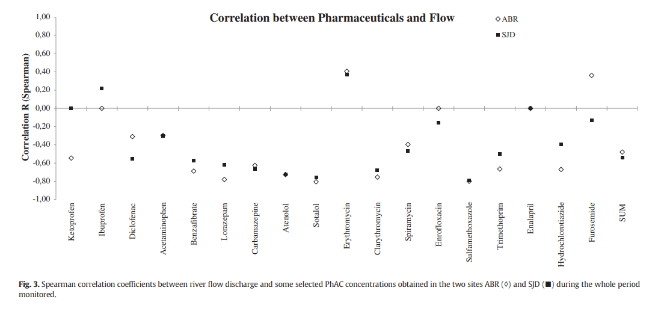
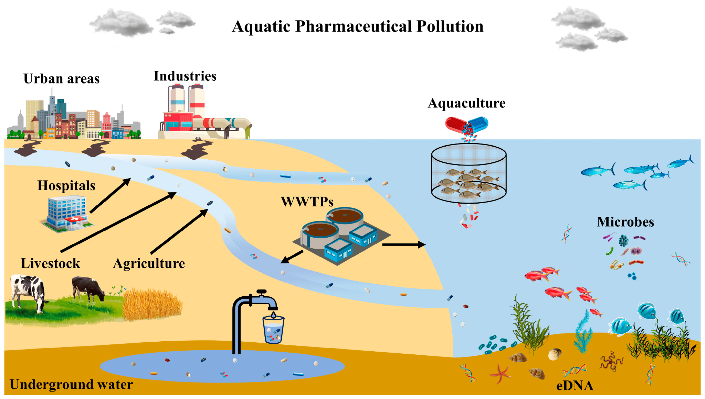
Influence of hydrological and physical aspects
Influence of longitudinal dimension and flow variations on APIs concentration in rivers :
Inverse correlation with river flow
Higher concentration downstream

Slide 11
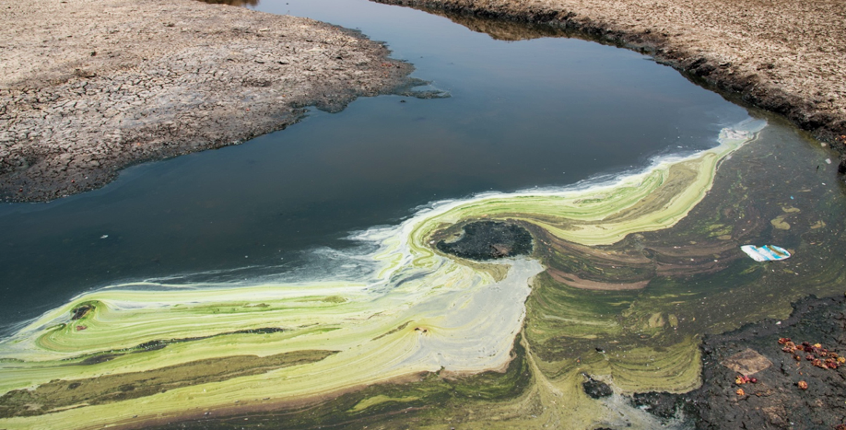
Socioeconomics of Pharmaceutical Pollution
Linked to income levels, Socioeconomic disparities in healthcare and infrastructure
Lower - middle income countries
  The most affected
  Better access to medicines (middle compared to low-income countries)
  Lack wastewater treatment infrastructure
  Drugs enter waterways untreated
High income countries
  Advanced wastewater management systems + tighter regulation
  Sower levels of pollution despite higher overall drug consumption
Source : https://www.reactgroup.org/news-and-views/news-and-opinions/year-2020/antibiotic-pollution-india-scores-a-global-first-with-effluent-limits/

Slide 12
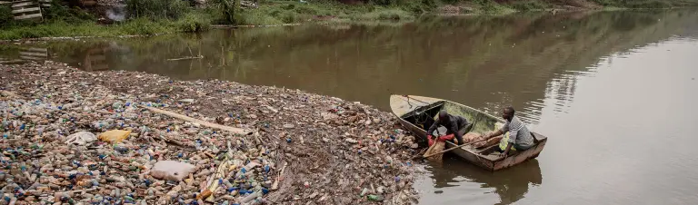
Socioeconomics of Pharmaceutical Pollution
Types of pharmaceuticals in rivers reflect socioeconomic trends
Lower income countries
  Antibiotics and painkillers
  Used / sold without strict regulation
High income countries
  Antidepressants / antihyperglycemic medications
  Different healthcare priorities
https://nypost.com/2022/06/22/43-of-worlds-rivers-contain-dangerous-levels-of-prescription-drugs/

Slide 13
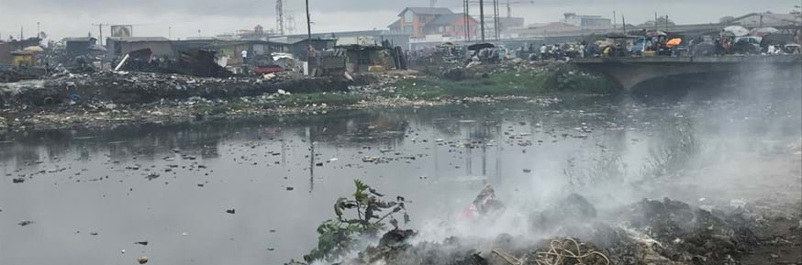
Socioeconomics of Pharmaceutical Pollution
Conclusion
Pharmaceutical pollution → not just an environmental issue → reflection of global socioeconomic inequalities
Investing in infrastructure, especially wastewater treatment, in lower-income regions.
Promoting responsible drug use and better regulatory frameworks globally.
Source : https://www.lancaster.ac.uk/lec/about-us/news/global-study-finds-the-extent-of-pharmaceutical-pollution-in-the-worlds-rivers

Slide 14
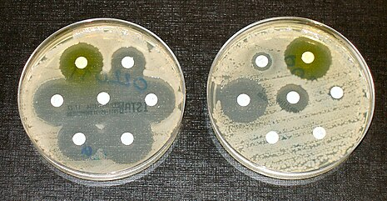
Health Impact
APIs designed to interact with biological systems
Accumulation in tissues → can enter food webs
Antimicrobial resistance
  Antibiotics create drug resistant bacteria, “superbugs”
  Microorganisms no longer respond to the available antimicrobial drugs
  Is considered as one of the greatest global health threats of the 21st century →increasing healthcare costs, hospital stays, and mortality rates
  Rivers act as pathways, spreading resistant bacteria downstream to larger water systems
Source : https://en.wikipedia.org/wiki/Antimicrobial_resistance

Slide 15
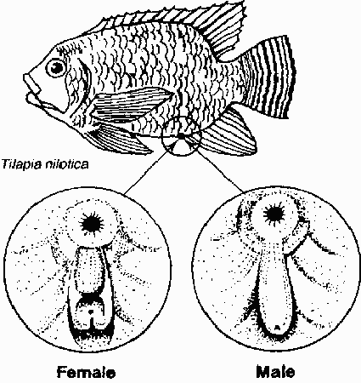
Impacts on Ecosystems
Impact health and behaviour
Hormonal drugs : feminization, impair reproduction, egg production, feeding habits, food web dynamics
→ Vulnerable to predators
  Amphibians (frogs, toads), fishes (trouts, minnows), invertebrates (freshwater snails) …
Decline in ecosystem biodiversity and ecological stability
  EE2 effects : decline of the relative abundance of young fish and in biomass of adult fathead minnow → consequence of their reproductive failure
  Antidepressant effects : hypoactivity or increased aggression
Source : https://www.topnews.in/when-male-fish-turn-female-2391677

Slide 16
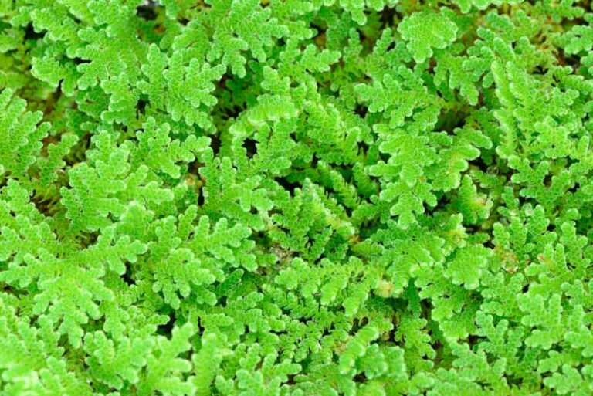
Biogeochemical cycles - N
Disruption of the biogeochemical cycles
Nitrogen cycle: ciprofloxacin (antibiotic) reduce nitrogenase activity in Azolla
  N2 → NH3 (anaerobic): rate of inert atmospheric nitrogen into a form usable by organisms decreased
Source: Azolla Cultivation Business Plan: A Step-By-Step Guide for Growing, Care, Benefits

Slide 17
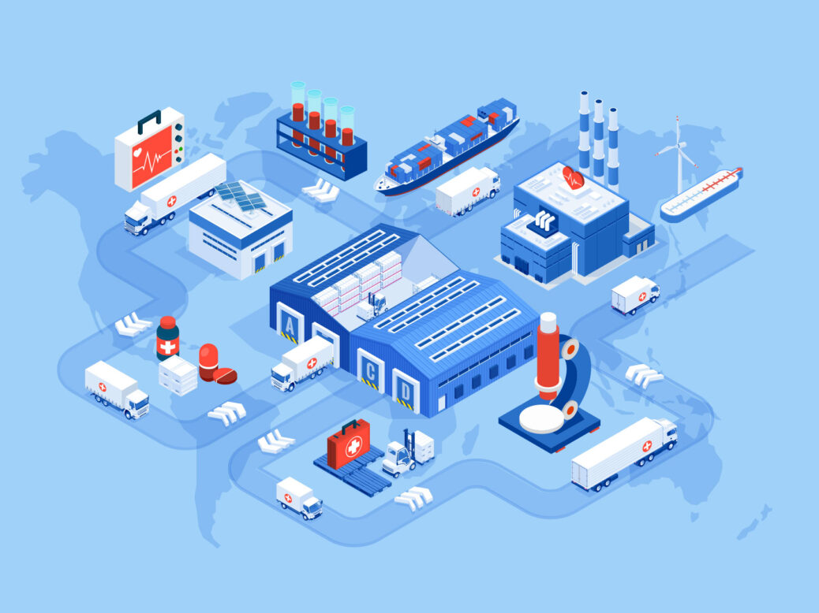
Biogeochemical cycles - C
Pharmaceuticals are among the most carbon-intensive components of healthcare
Global biotechnology and pharmaceutical industry’s carbon footprint greater than many other major industries ( forestry, paper, …)
Source: Cutting the carbon footprint of pharma’s supply chain - Supply Chain Council of European Union | Scceu.org

Slide 18
Biogeochemical cycles - O
Pharmaceutical pollutants introduce recalcitrant molecules that are difficult for microorganisms to break down, leading to increased oxygen consumption!
Diatoms’ perspective on:
Oxygen
  Generate ∼40% world's oxygen (through photosynthesis)
  Known as bio-indicators for water quality studies
  High pharmaceutical concentrations → cell deformities and mortality rates
  Less O2

Slide 19
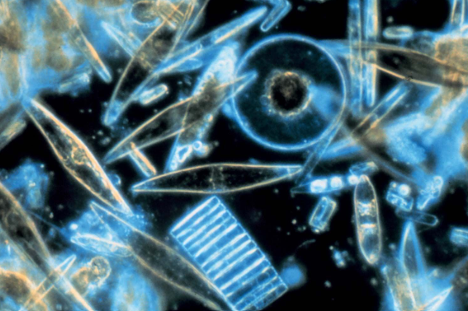
Foodweb impacts
Diatoms’ perspective on:
Food webs in general:
  Vital food source for primary consumers
  Less biomass due to mortality rate
  Bioaccumulation + biomagnification
Source: Diatom | Description, Characteristics, & Reproduction | Britannica

Slide 20
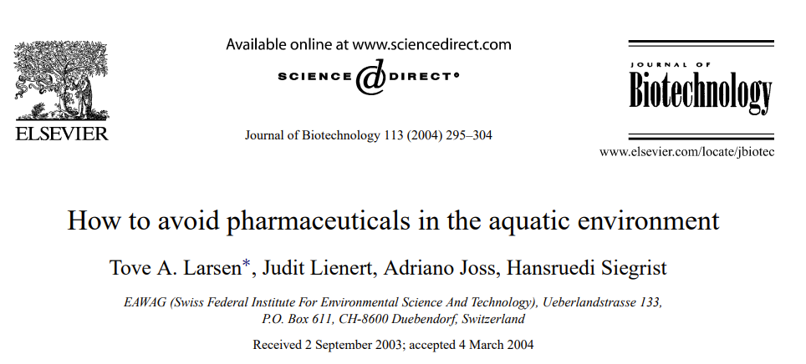
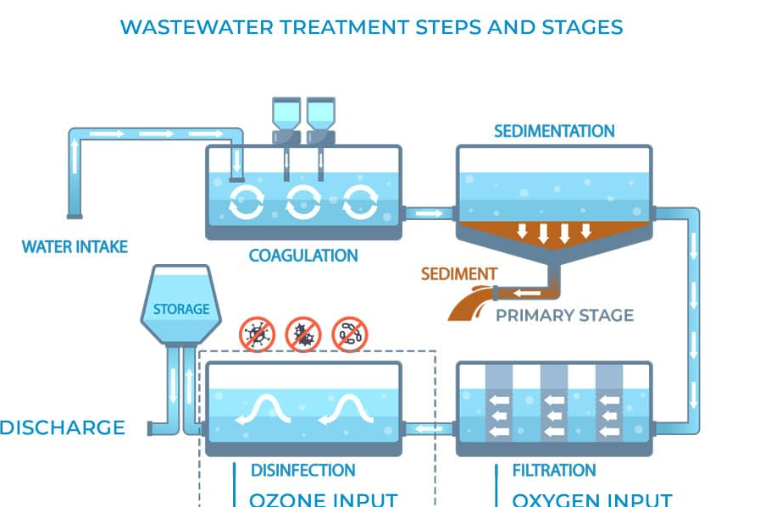
Solutions and call for action
Effluents from wastewater treatment plants are one of the main sources of APIs in aquatic ecosystems.
Most used treatments for APIs removal:
Biological treatment
Disinfection by ozone
In the long term:
Urine source separation

Slide 21
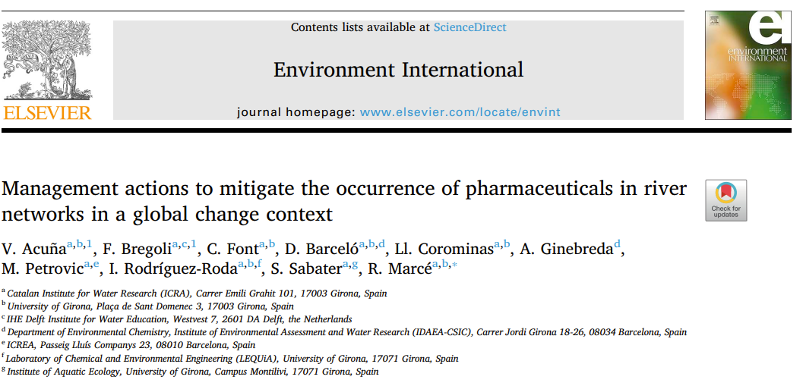
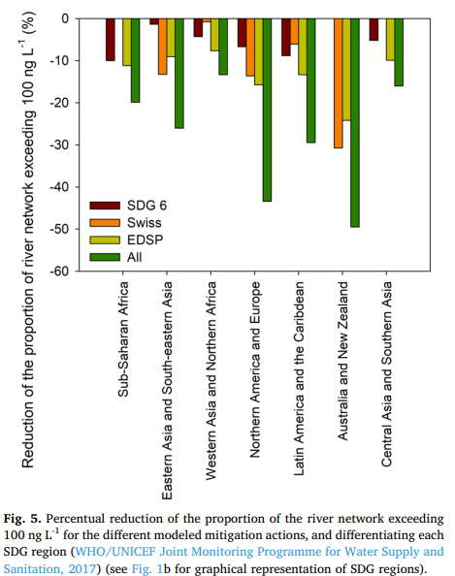
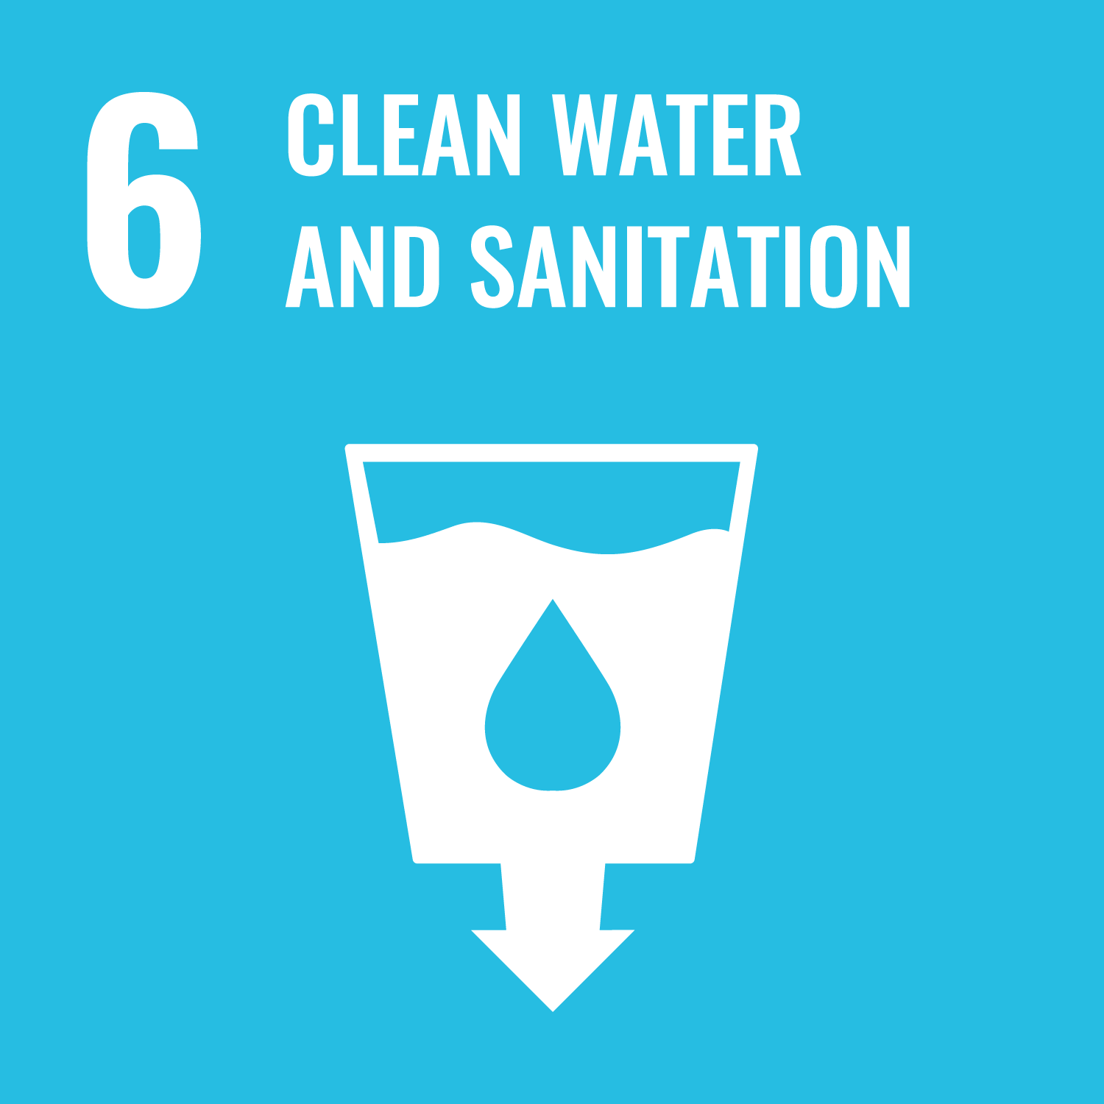
Solutions and call for action
Only technological solutions are not enough:
Need to be combined with other mitigation actions
Proposed end-of-the pipe actions:
Per capita consumption reduction through eco-directed sustainable prescribing (EDSP)
Implementation of the United Nations Sustainable Development Goal (SDG) 6

Slide 22

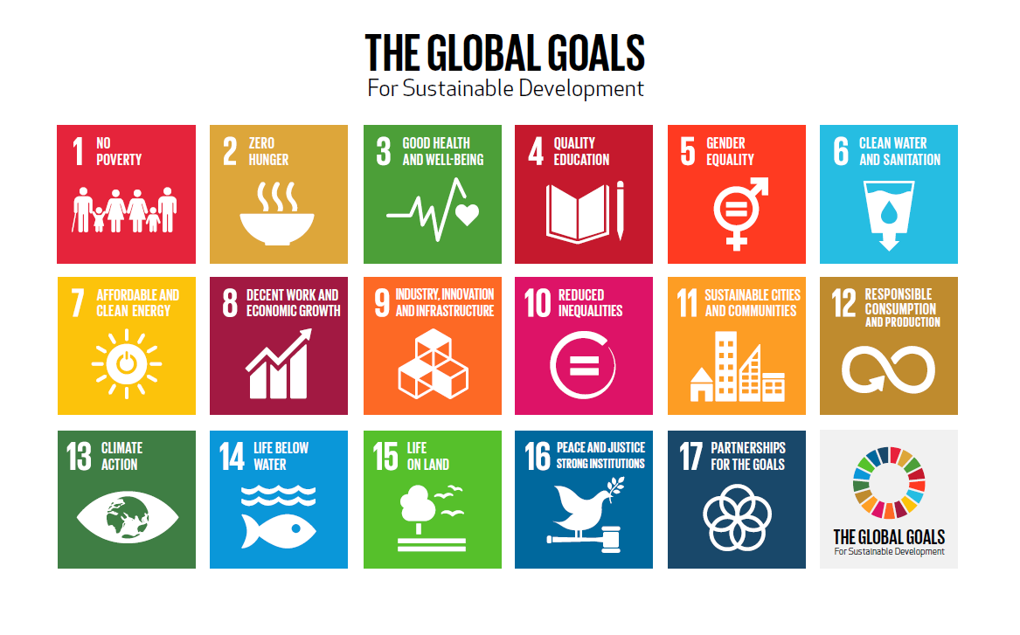
Conclusion
Pollution of the world’s rivers by medicinal chemicals is a global problem that:
Poses risk aquatic ecosystems and their biogeochemical cycles
May risk achievement of the United Nations Sustainable Development Goals by 2030.
Importance for the development of global-scale datasets on pollution.

Slide 23
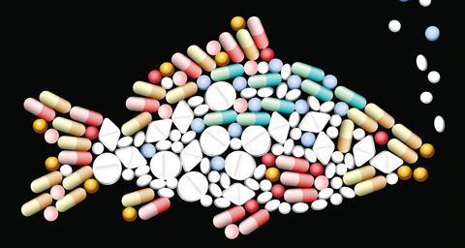
Thank you for your attention !
Source: Study Shows Ocean Fish Loaded With Pharmaceuticals

Slide 24
Sources and Literature
Fisher Jonah, Pharmaceuticals in rivers threaten world health - study, 15th February 2022, BBC, url:Pharmaceuticals in rivers threaten world health - study
John Wilkinson and et al., Pharmaceutical pollution of the world’s rivers, 2022, PNAS Vol. 119 No. 8, url: Pharmaceutical pollution of the world’s rivers
Victoria Osorio, Lorenzo Proia , Marta Ricart , Sandra Pérez ,, Antoni Ginebreda , Jose Luís Cortina , Sergi Sabater , Damià Barceló,
Hydrological variation modulates pharmaceutical levels and biofilm responses in a Mediterranean river, 17 december 2013
V. Acuñaa, F. Bregolia, C. Fonta, D. Barcelóa, , Ll. Corominasa, A. Ginebredad , M. Petrovica, I. Rodríguez-Rodaa, S. Sabatera, R. Marcéa, Management actions to mitigate the occurrence of pharmaceuticals in river networks in a global change context, 29 July 2020
Tove A. Larsen, Judit Lienert, Adriano Joss, Hansruedi Siegrist, EAWAG (Swiss Federal Institute For Environmental Science And Technology), Ueberlandstrasse 133, P.O. Box 611, CH-8600 Duebendorf, Switzerland, March 2004, How to avoid pharmaceuticals in the aquatic environment
Helena de Oliveira Souza and al., How Can We Help to Prevent Medicines From Polluting the Environment?, 13 June 2019
Md Khaled Mosharaf and al., Wastewater reuse and pharmaceutical pollution in agriculture: Uptake, transport, accumulation and metabolism of pharmaceutical pollutants within plants, Chemosphere, Volume 364, 2024, 143055, ISSN 0045-6535,Wastewater reuse and pharmaceutical pollution in agriculture: Uptake, transport, accumulation and metabolism of pharmaceutical pollutants within plants - ScienceDirect
A. Kock and al., Emerging challenges of the impacts of pharmaceuticals on aquatic ecosystems: A diatom perspective, Science of The Total Environment, Volume 878, 2023, 162939, ISSN 0048-9697, Emerging challenges of the impacts of pharmaceuticals on aquatic ecosystems: A diatom perspective - ScienceDirect
Parker, G.; Miller, F.A. Tackling Pharmaceutical Pollution Along the Product Lifecycle: Roles and Responsibilities for Producers, Regulators and Prescribers. Pharmacy 2024, 12, 173. Tackling Pharmaceutical Pollution Along the Product Lifecycle: Roles and Responsibilities for Producers, Regulators and Prescribers

Slide 25
Sources and Literature
Sagar Reddy and others, Antimicrobial resistance in urban river ecosystems, October 2022, Microbiological Research, https://www.sciencedirect.com/science/article/pii/S0944501322001756#sec0030
Moa Säfholm and others, Risks of hormonally active pharmaceuticals to amphibians: a growing concern regarding progestagens, November 14th, 2014, National Library of Medicine, https://pmc.ncbi.nlm.nih.gov/articles/PMC4213589/
Diana Gomes Moreira and others, Levels and effects of antidepressant drugs to aquatic organisms, June 2022, Comparative Biochemistry and Physiology Part C: Toxicology & Pharmacology, https://www.sciencedirect.com/science/article/pii/S1532045622000576
Nestor Martinez and Mariana Cuautle, Impact of Pharmaceutical Waste on Biodiversity, December 2017, Ecopharmacovigilance, https://www.researchgate.net/publication/322127132_Impact_of_Pharmaceutical_Waste_on_Biodiversity
Pashaei Reza and others, Effects of Pharmaceuticals on the Nitrogen Cycle in Water and Soil: A Review, Environmental Monitoring and Assessment, January 19th, 2022, https://pure.sruc.ac.uk/ws/portalfiles/portal/44956784/Pashaei2022_Article_EffectsOfPharmaceuticalsOnTheN.pdf
Md Khaled Mosharaf and others, Wastewater reuse and pharmaceutical pollution in agriculture: Uptake, transport, accumulation and metabolism of pharmaceutical pollutants within plants, September 2024, Chemosphere, https://www.sciencedirect.com/science/article/pii/S0045653524019507
Shola D. Kayode-Afolayan and others, Impacts of pharmaceutical effluents on aquatic ecosystems, September 2022, Scientific African, https://www.sciencedirect.com/science/article/pii/S2468227622001958
Gillian Parker and Fiona A Miller, Tackling Pharmaceutical Pollution Along the Product Lifecycle: Roles and Responsibilities for Producers, Regulators and Prescribers, November 22th, 2022, National Library of Medicine, https://pmc.ncbi.nlm.nih.gov/articles/PMC11587451/

Slide 26
Citations
"This is only going to get worse as we are increasingly using pharmacological solutions to any illness whether physical or mental."
Dr Veronica Edmonds-Brown, an aquatic ecologist from the UK's University of Hertfordshire for BBC News
"One of the few things that could have an effect right now is the proper use of medicines." That would mean making it harder to get hold of medicines like antibiotics, and tighter restrictions on doses.
Dr John Wilkinson, who led the research, BBC News.

Slide 27
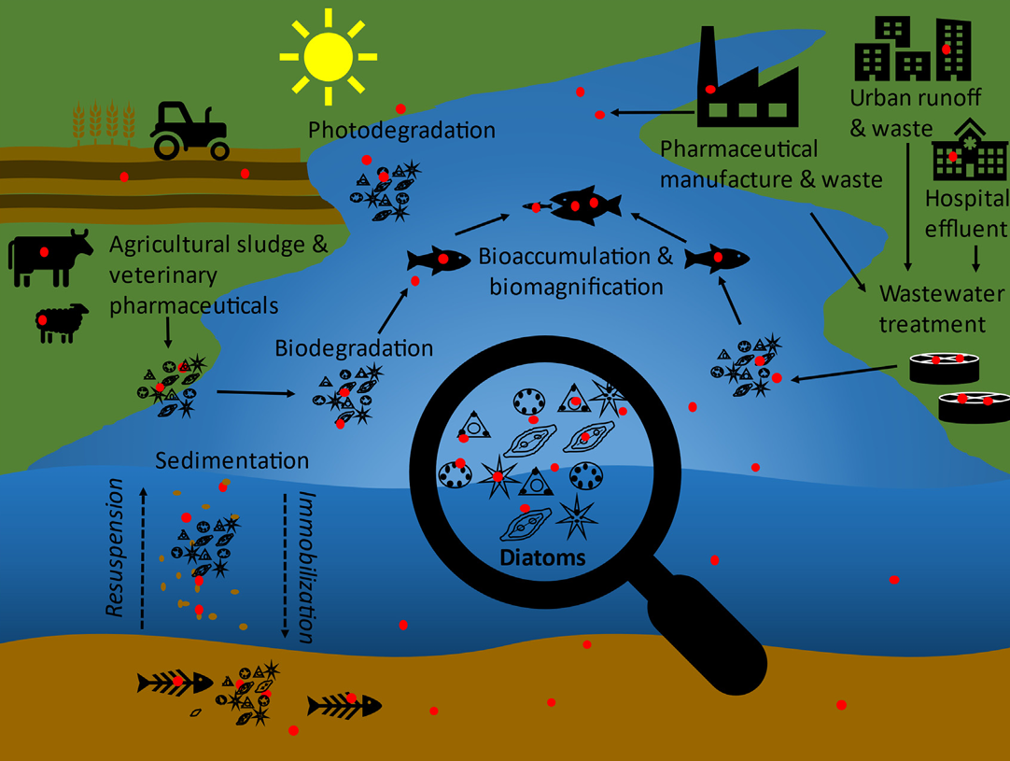
Souece: Emerging challenges of the impacts of pharmaceuticals on aquatic ecosystems: A diatom perspective - ScienceDirect

Slide 28
Impacts on Biogeochemical cycles
Nitrogen cycle
  observed modifications in nitrogen fixation processes
  leading to reduced photosynthetic and nitrogenase activities
  Nitrogenase plays a central role in maintaining the nitrogen cycle, which is essential for plant growth and the overall health of ecosystems
Oxygen cycle
  oxygen depletion of water bodies as a result of pharmaceutical by-products
  Pharmaceutical pollutants introduce recalcitrant molecules which are hard to break down
  depletion of oxygen caused by increased oxygen consumption due to increased microbial activity
  Aggregates of suspended solids result in the inaccessibility of sunlight to algae and cyanobacteria that are responsible for the production of food for the ecosystem

Slide 29
Impacts on Biogeochemical cycles
Carbon cycle
  Pharmaceuticals are among the most carbon-intensive components of healthcare
  global biotechnology and pharmaceutical industry’s carbon footprint is reported to be greater than many other major industries, including forestry, paper, and semiconductors
Long term ecosystem changes
  can affect food web dynamics, leading to shifts in species composition
  For example, a decline in fish populations due to hormonal disruption can lead to an overabundance of certain invertebrates, impacting the balance of the ecosystem
  These changes can create a less stable ecosystem, making it more vulnerable to other environmental stressors

